Slide 1

Learn Docker from scratch
Subscribe my YouTube Channel
“SimplyLearn”

Slide 2
Pre-requisite Knowledge: Required: Basic understanding of Linux/Windows OS

Slide 3
What is docker?
Docker is a computer program that performs operating-system-level virtualization, it is also known as "containerization".
Containers are isolated from each other and bundle their own application, tools, libraries and configuration files; they can communicate with each other through well-defined channels. All containers are run by a single operating-system kernel and are thus more lightweight than virtual machines.

Slide 4
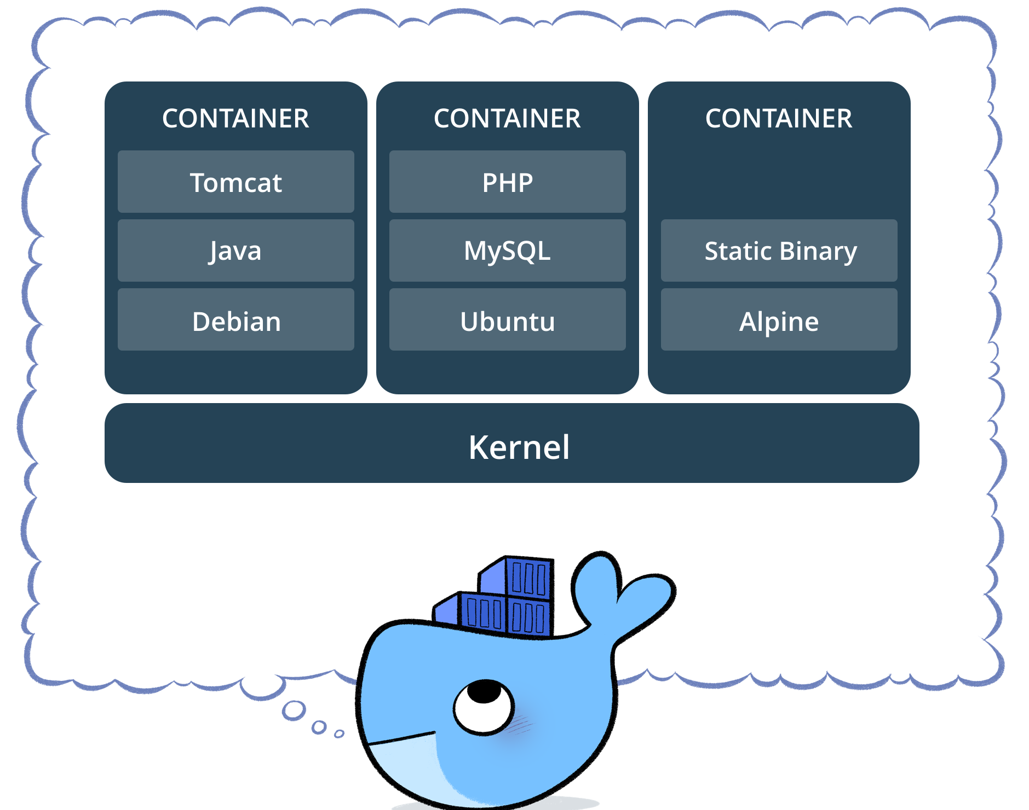

Slide 6
Thank you for watching…!!!
Please like this video and
Click the “Subscribe” button below

